Slide 1


Bioinformatics Final Deliverables
Tanish Kumar

Slide 2
A Little Bit About Me
I am a sophomore at Stanford Online High School.
I am interested in anything STEM-related! I particularly enjoy programming and physics.
My motivation to join Stem-Away was to get practice programming in a biological context, and to try out the field of bioinformatics to see how I like it.

Slide 3
Background
Run 34 samples(17 normal and 17 cancer) through a bioinformatics analysis pipeline.
Used GSM22598 and used only homogenized samples.

Slide 4
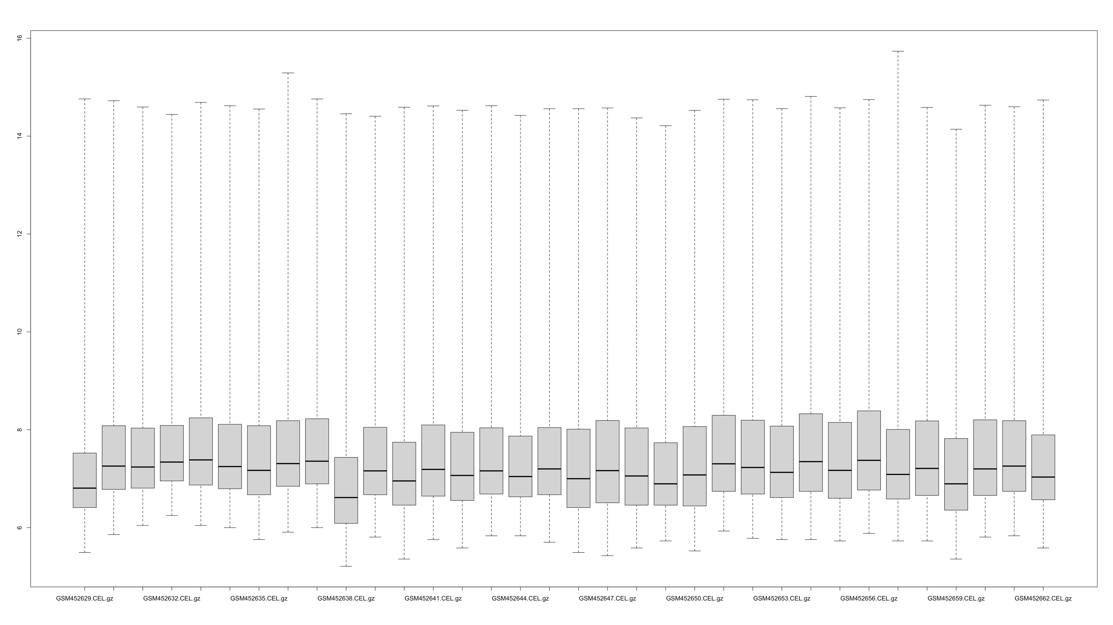
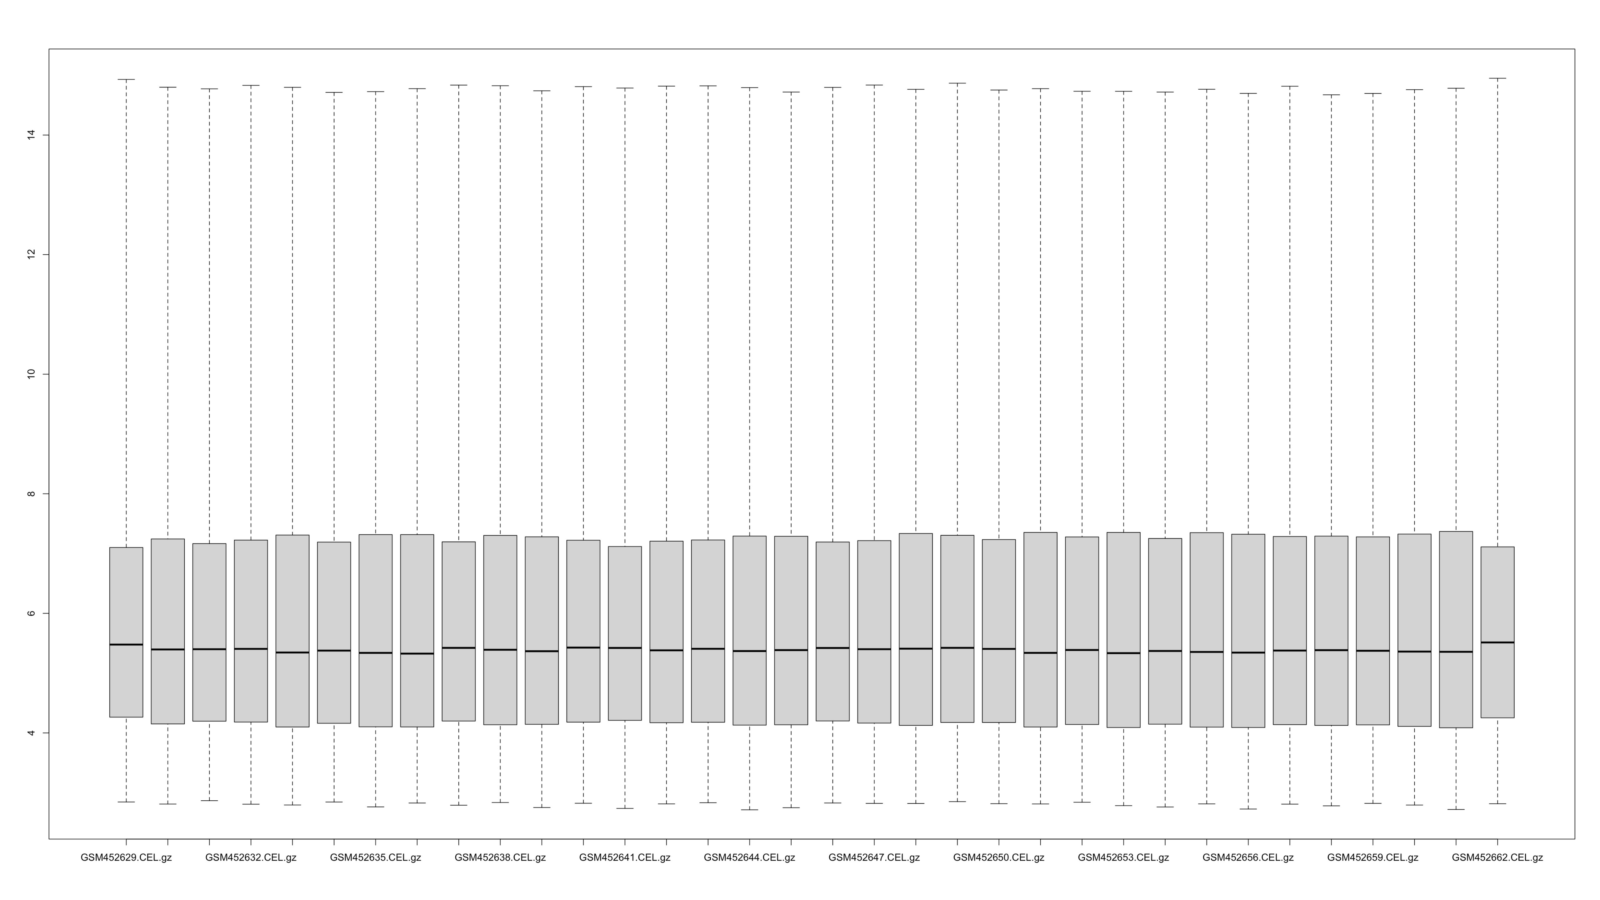
Box Plot of Samples Before and After Normalization
Initially, Samples #1, #10, and #34 stuck out in the plot.
After normalization, Sample #34 sticks out in the plot.

Slide 5

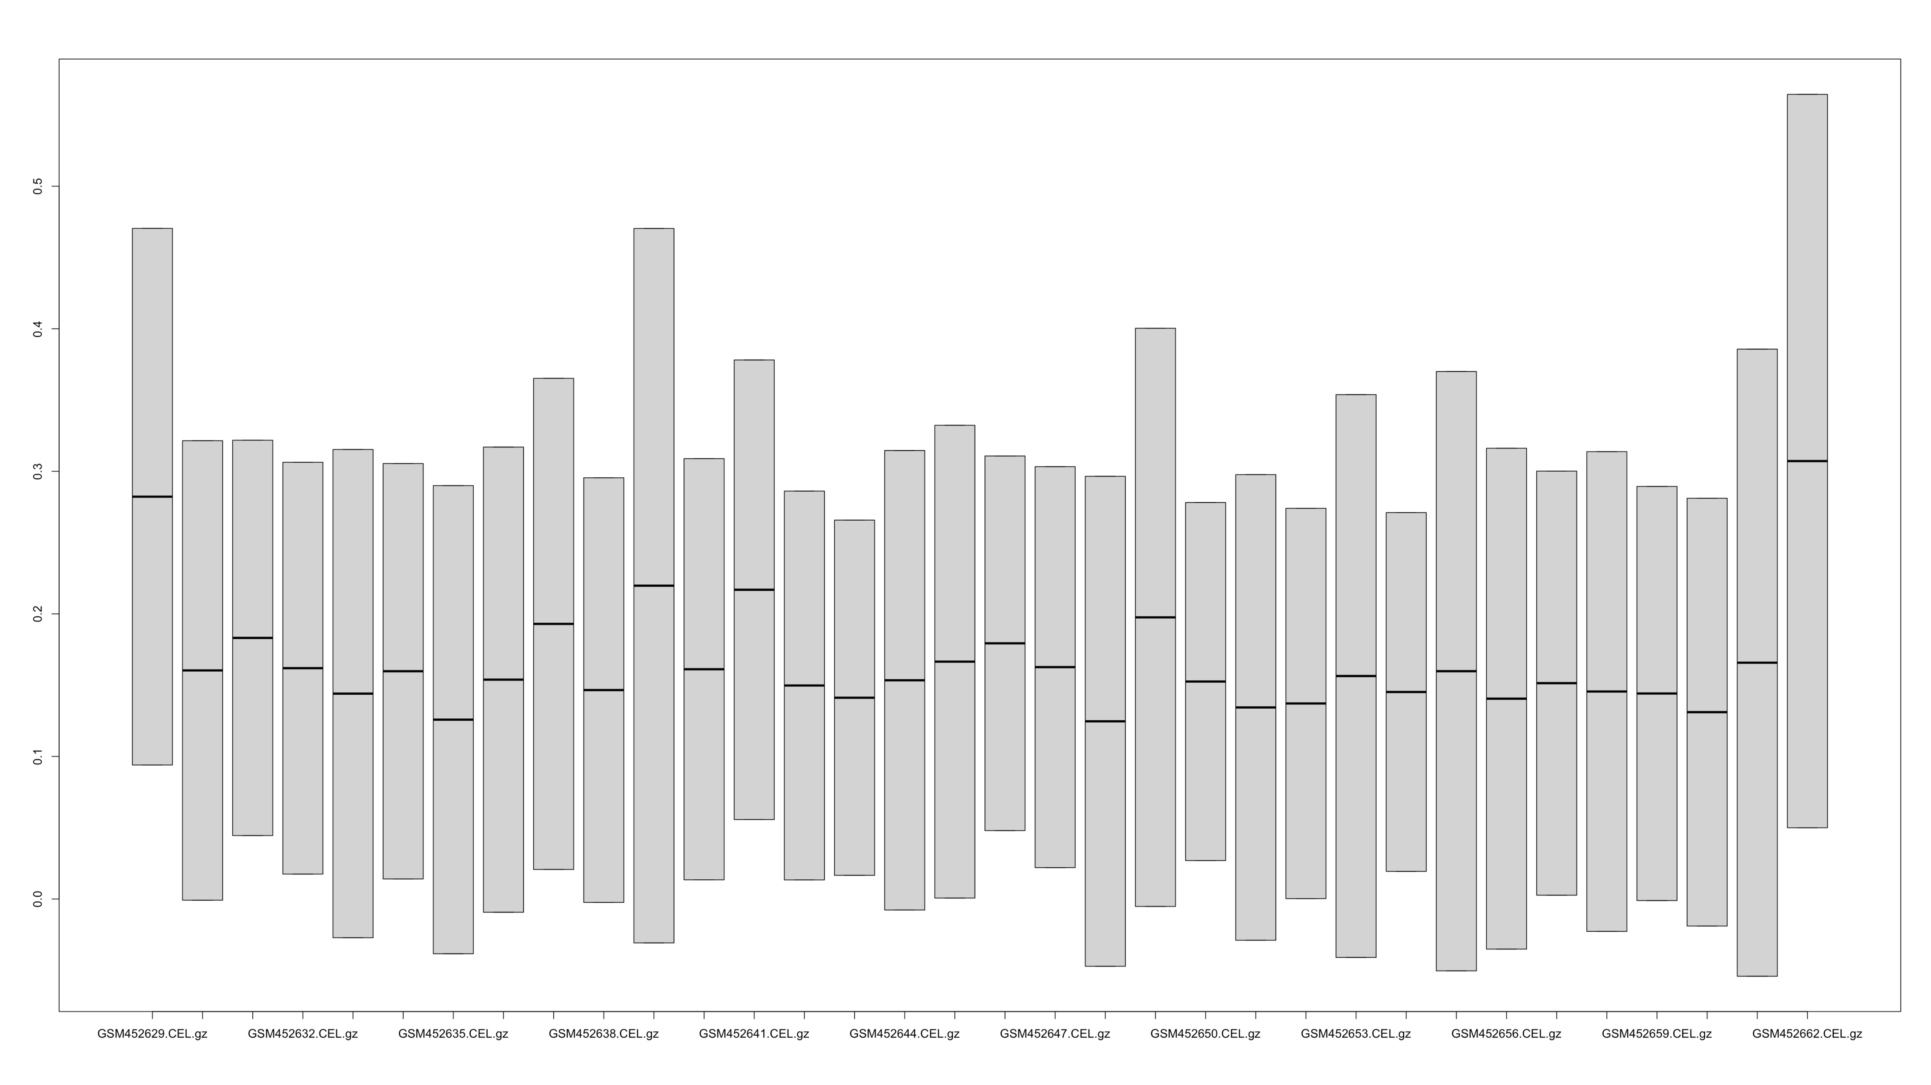
RLE Data
Samples #1 and #34 stick out in the box plot.

Slide 6
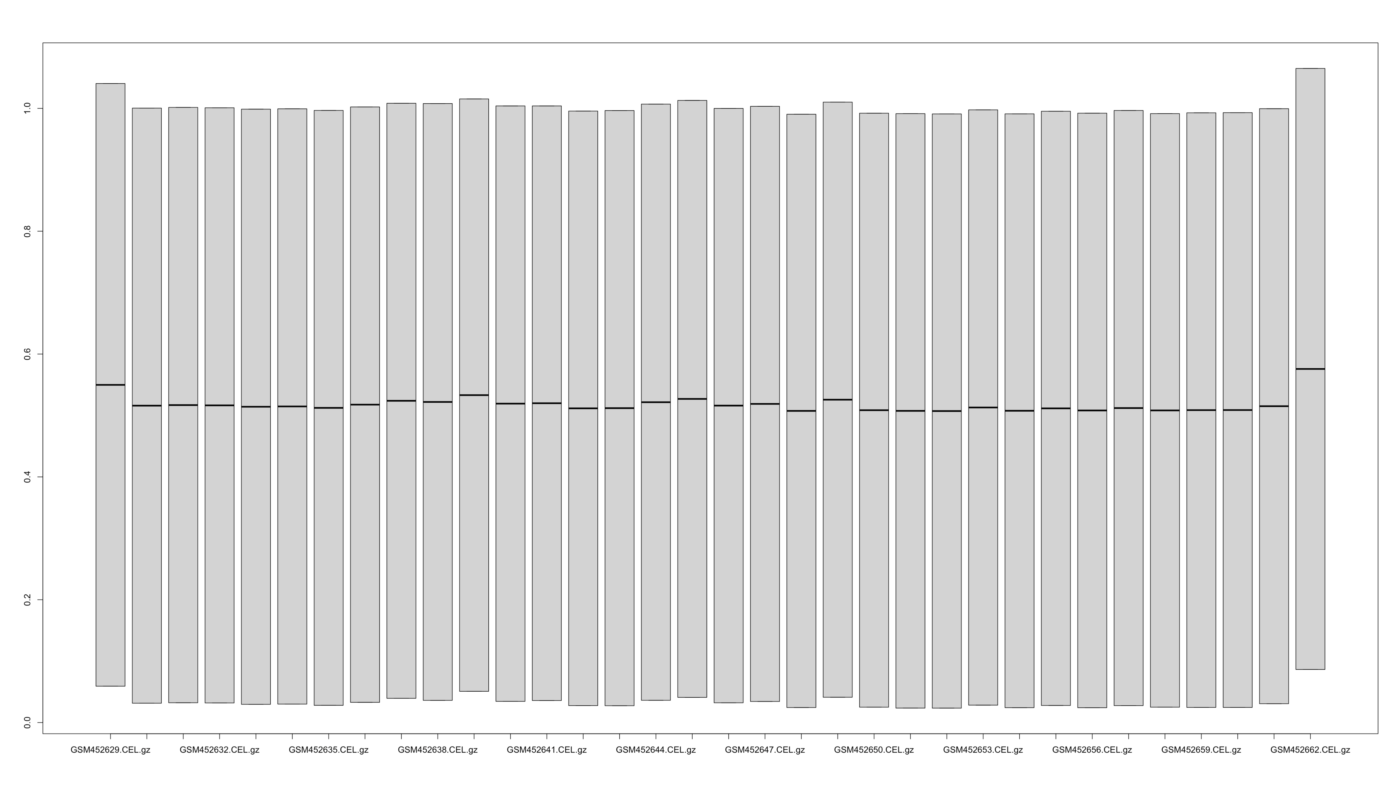
NUSE Data
Samples #1 and #34 stick out slightly in the box plot.

Slide 7
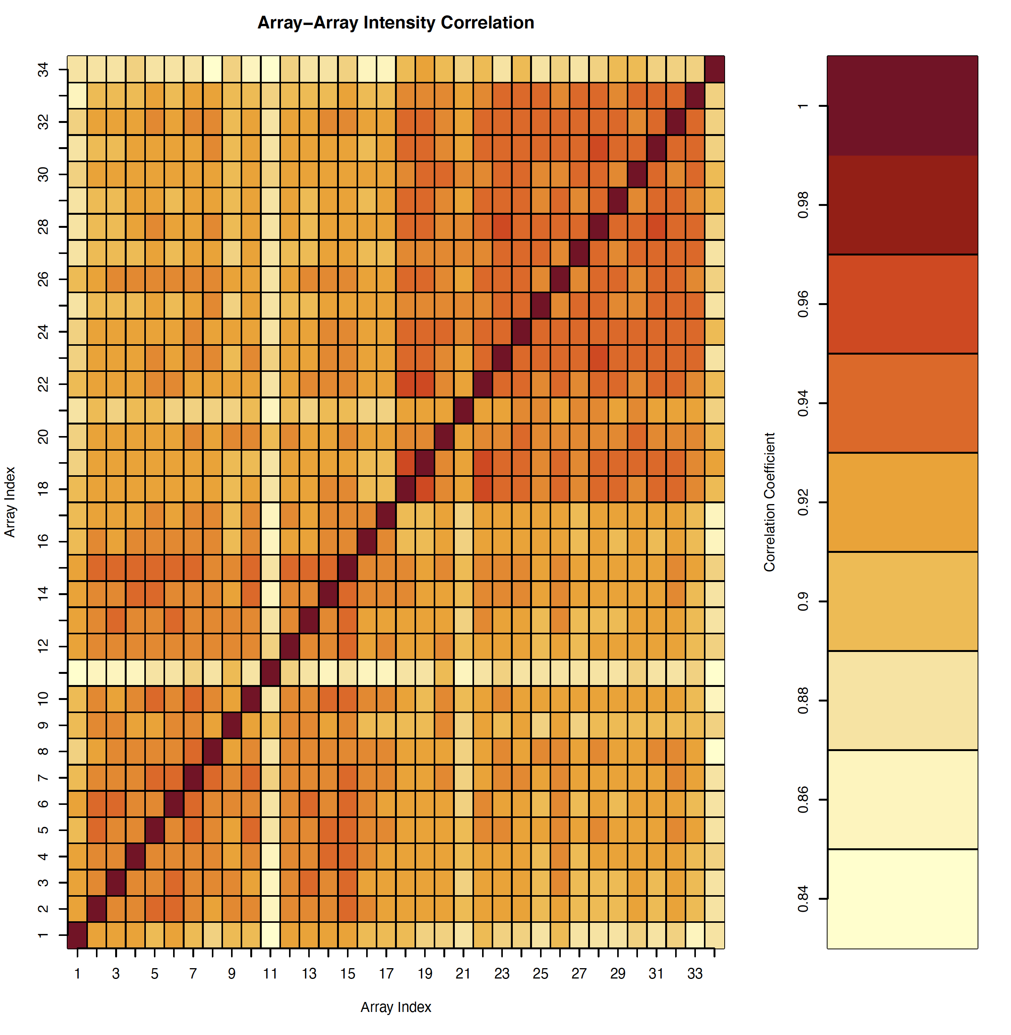
Heat Map (QCReport)
Samples #11 and #34 stick out slightly in the plot which is a sign of bad quality.
However, we can see some clustering which is a sign of overall good quality.

Slide 8
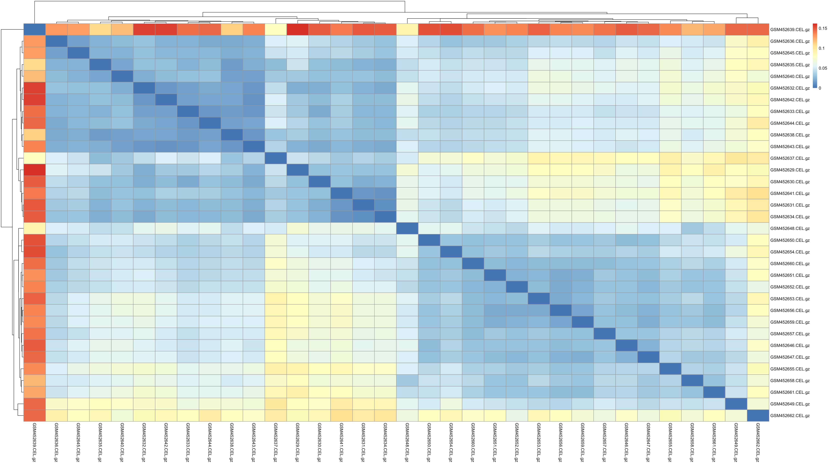
Heat Map (pheatmap)
Sample 11(GSM452639) sticks out very clearly which is a sign of bad quality.
We see good clustering here as well.

Slide 9
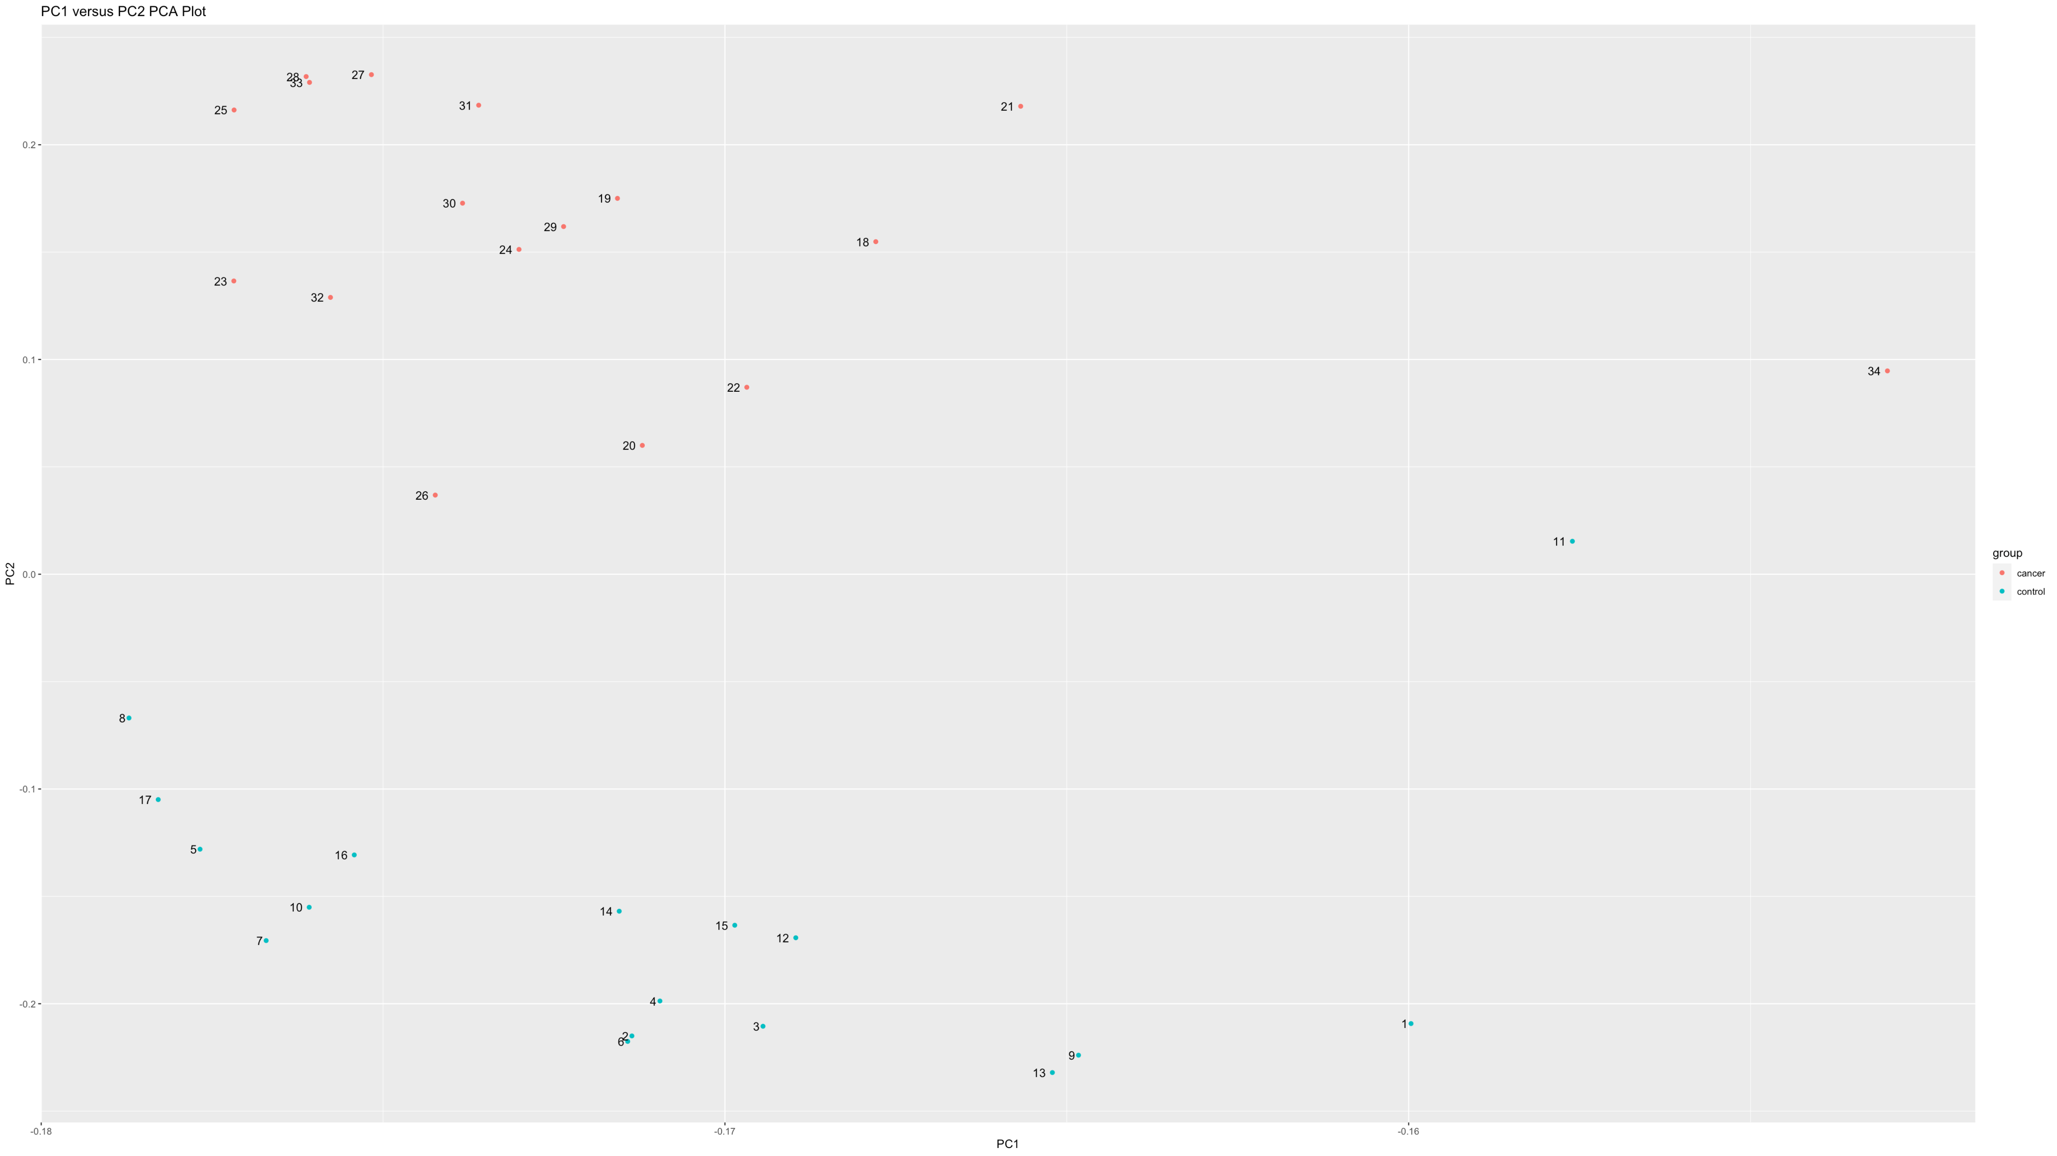
PCA Plot
Again, we see Samples #11 and #34 as outliers (bad quality).
Overall, we can see a clear control group cluster and a cancer group cluster.

Slide 10
Sample #11 was removed before performing further analysis.

Slide 11
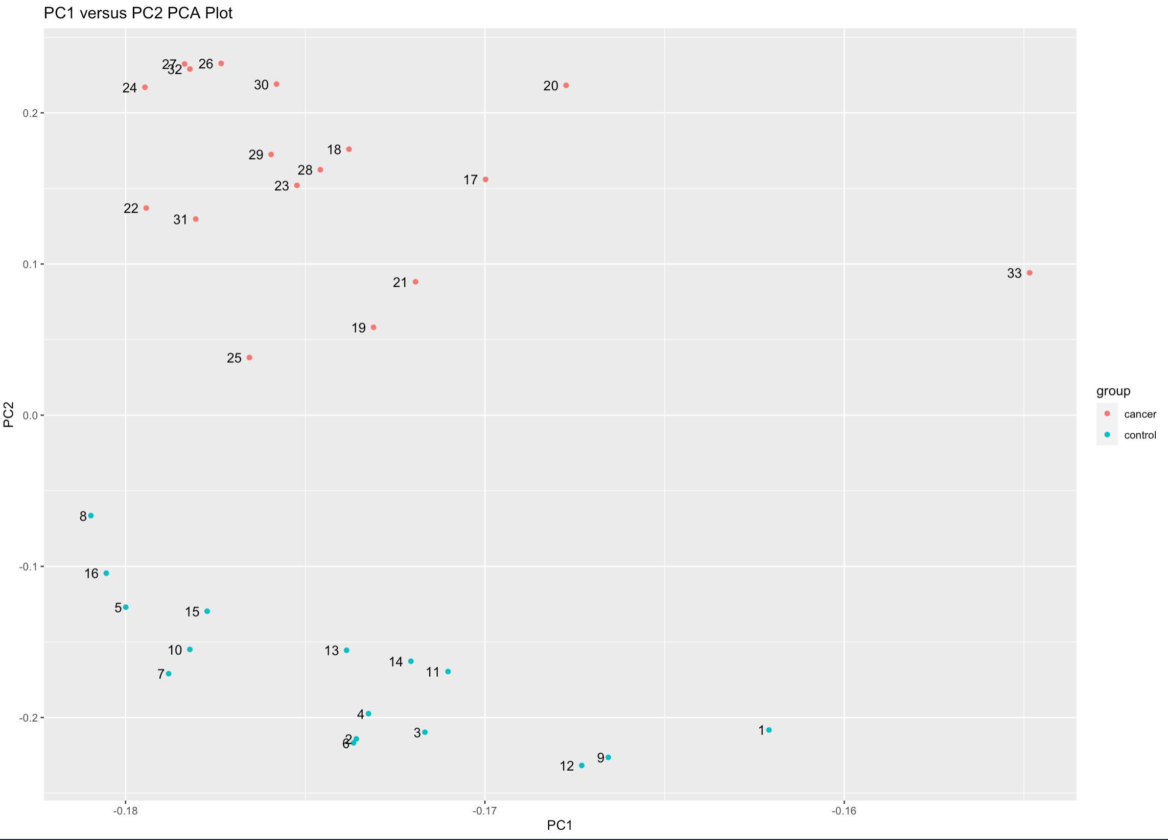
PCA Plot #2
Sample #33 could be considered and outlier however it did not appear to be extremely bad quality in the other plots.
Otherwise, there is very clear clustering.

Slide 12
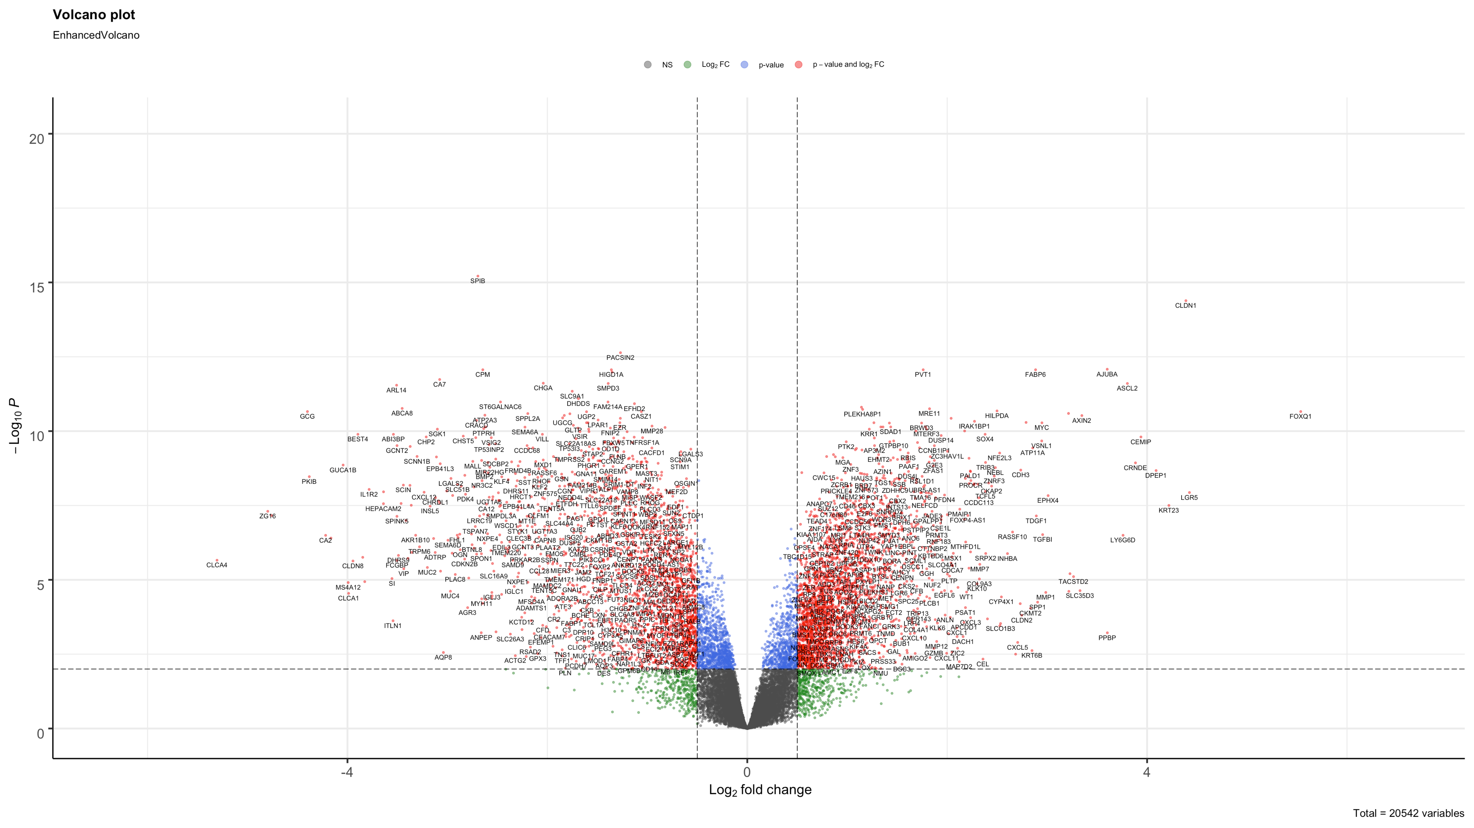
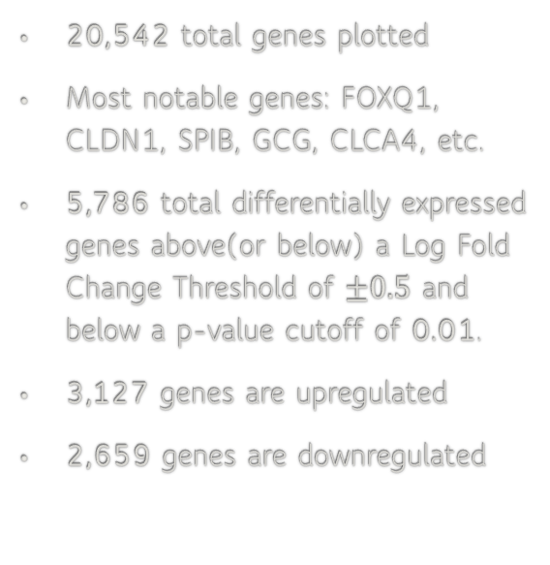
Volcano Plot
20,542 total genes plotted
Most notable genes: FOXQ1, CLDN1, SPIB, GCG, CLCA4, etc.
5,786 total differentially expressed genes above(or below) a Log Fold Change Threshold of $±0.5$ and below a p-value cutoff of 0.01.
3,127 genes are upregulated
2,659 genes are downregulated

Slide 13
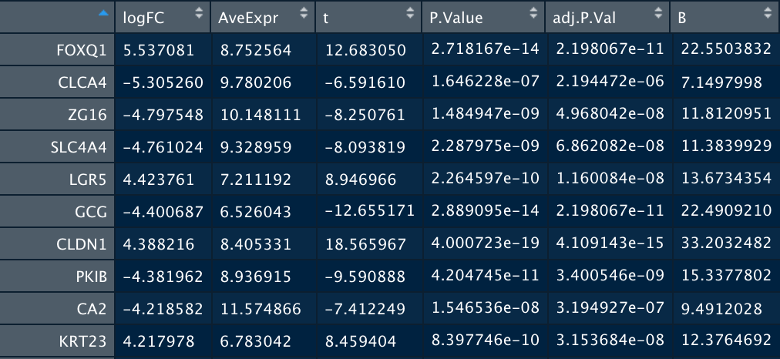
Top Ten Differentially Expressed Genes

Slide 14

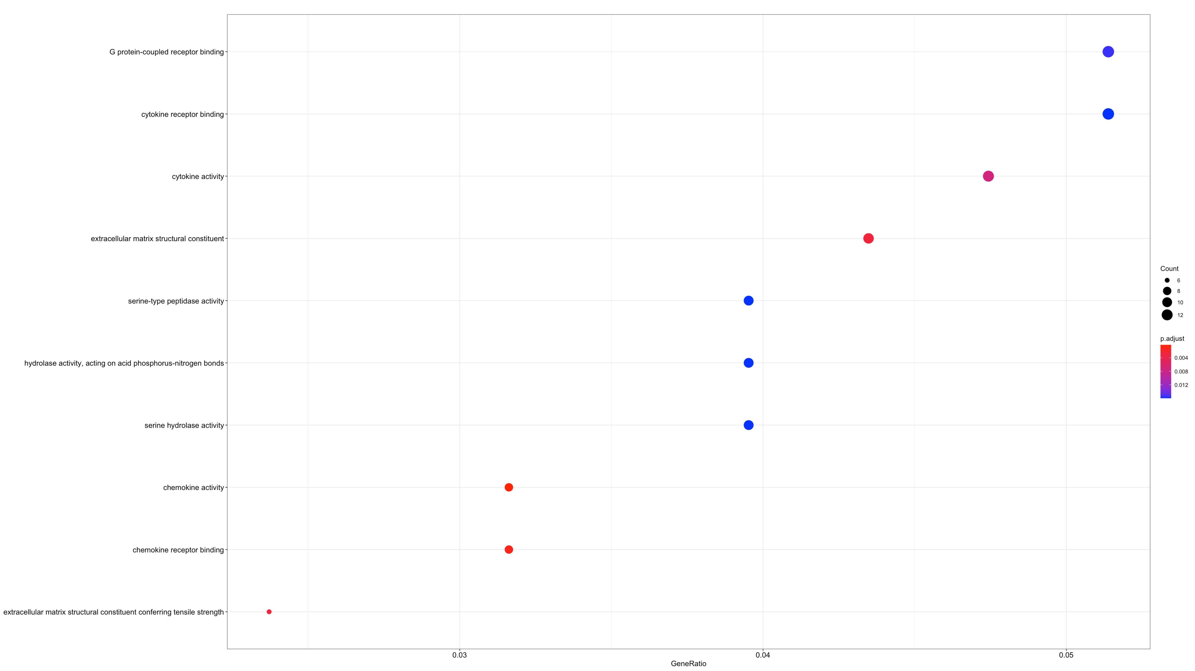
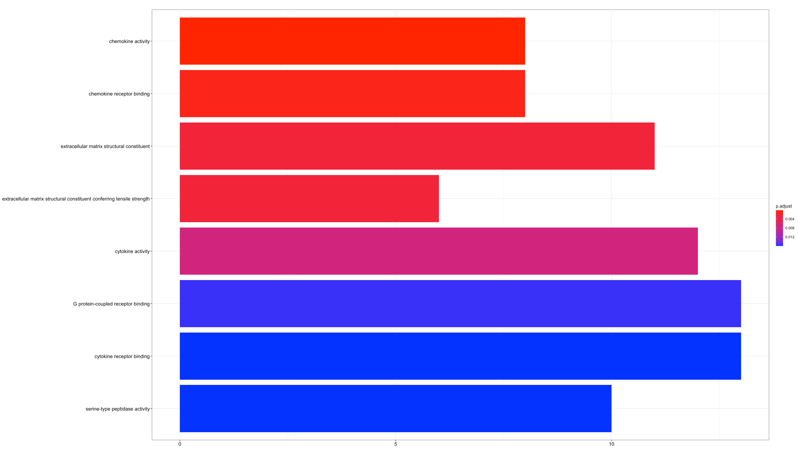
enrichGo Result

Slide 15
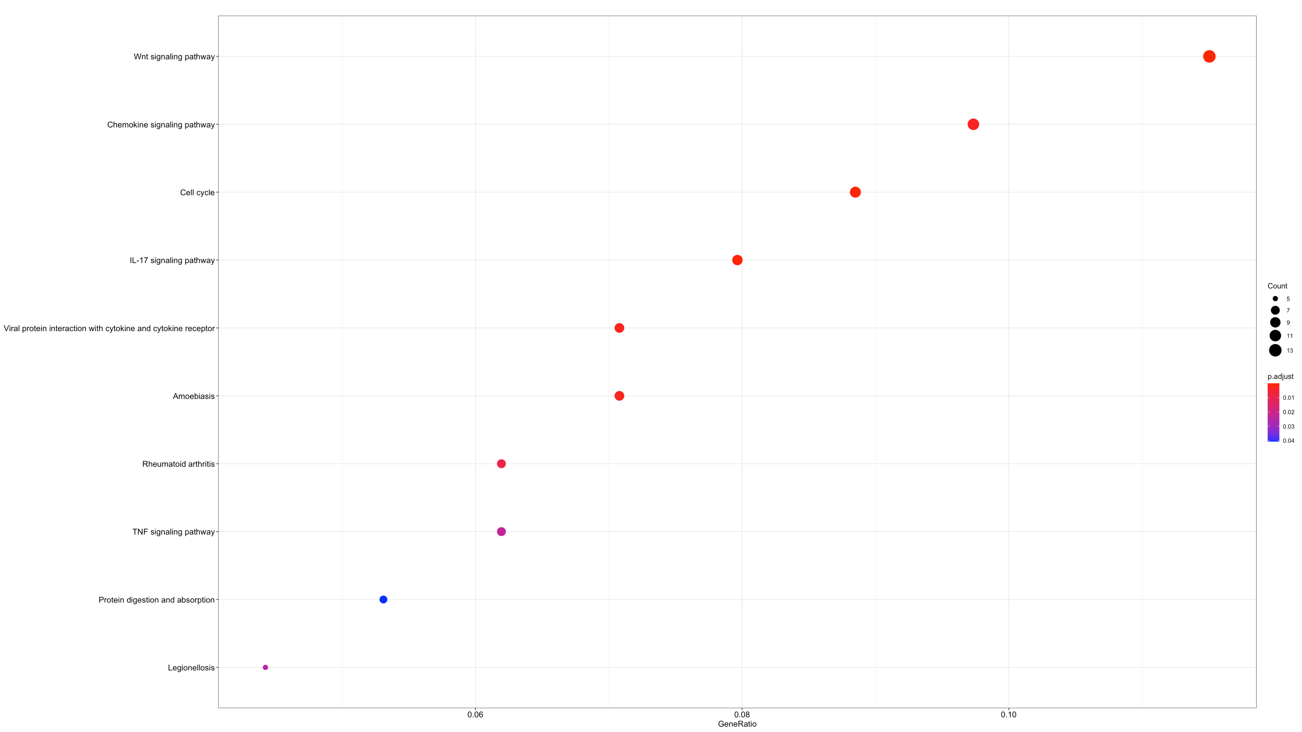
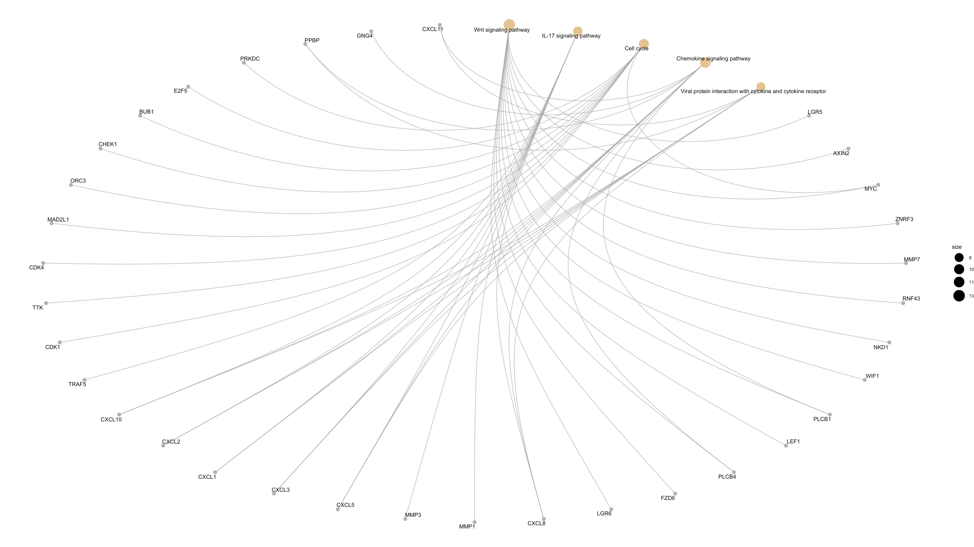
EnrichKEGG Result

Slide 16
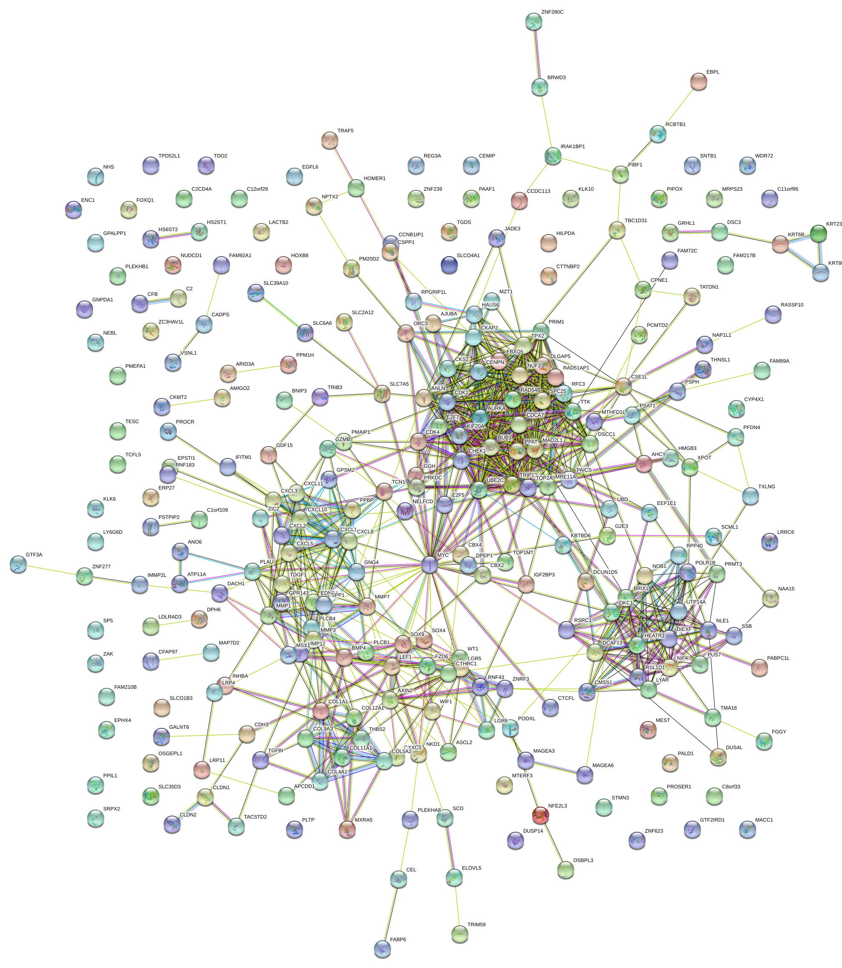
STRING PPI Network

Slide 17
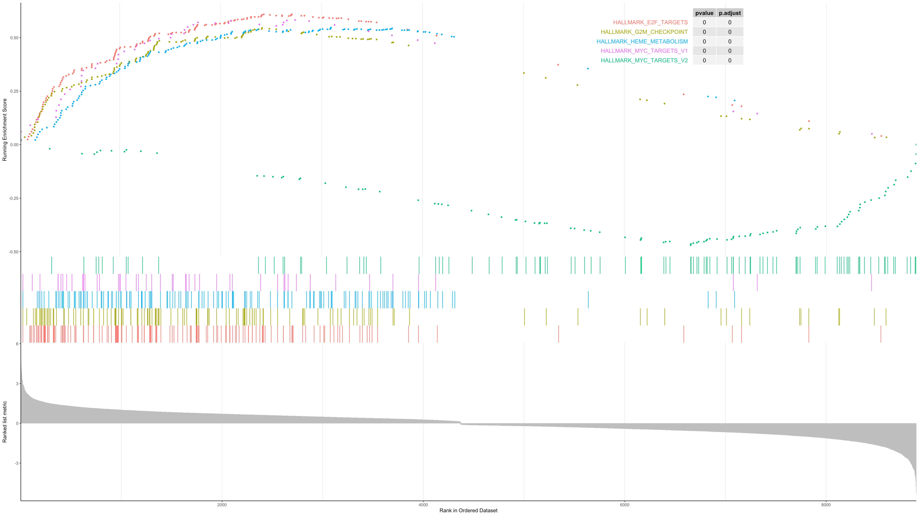
GSEA Plot

Slide 18
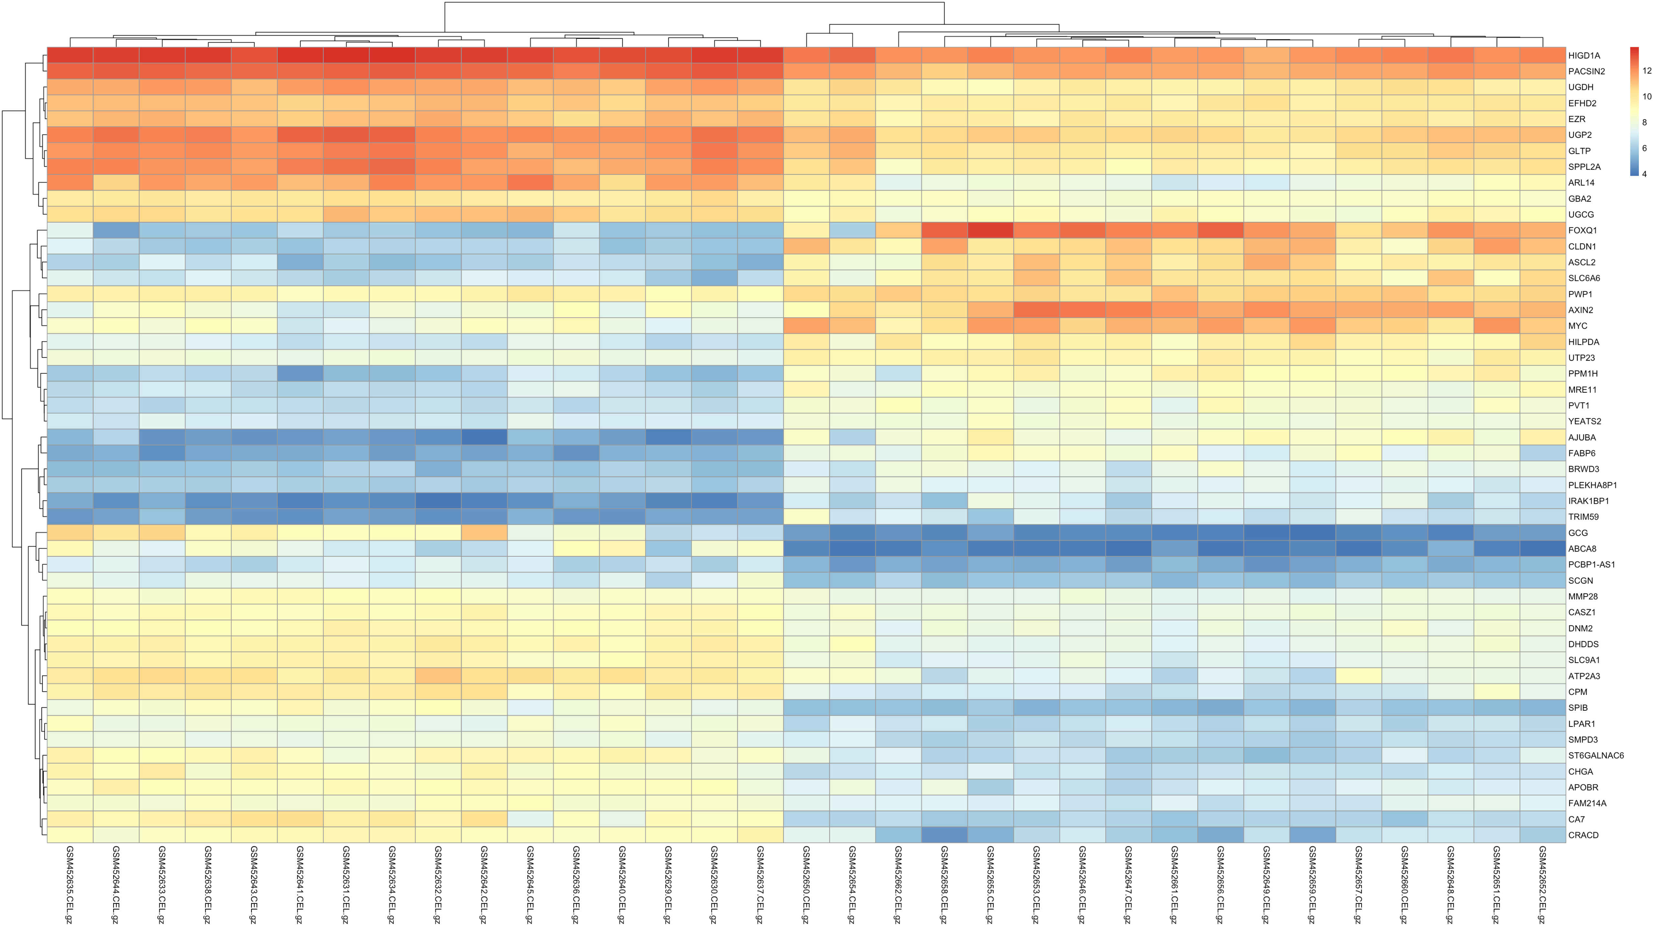
Heat Map of Top 50 DEGs

Slide 19
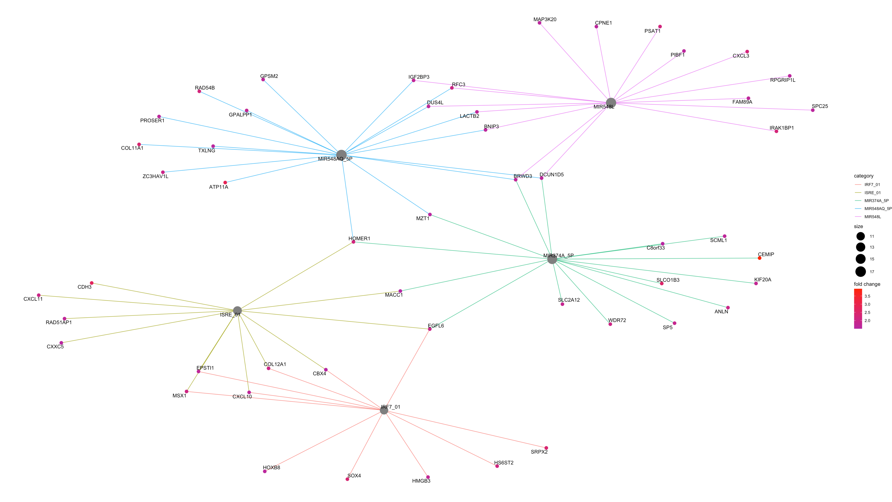
Transcriptional Factor Analysis – CNET Plot

Slide 20
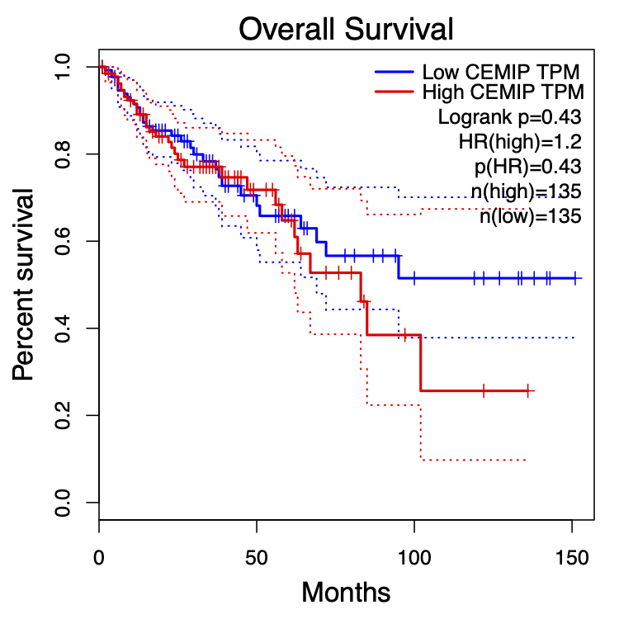
GEPIA Survival Curve Plot - CEMIP

Slide 21
Pipeline Summary
Quality Control
Finding DEGs
Functional Analysis/PPI Network
Transcriptional Factor Analysis
Used affyPLM, affyQCReport, and pheatmap packages
Generated RLE and NUSE plots and heatmaps.
Generated PCA Plots using prcomp()
Found Sample #11 as having bad quality and removed it
Used model.matrix, the limma package, and EnhancedVolcano
Discovered 5,786 differentially expressed genes
Used cnetplot() and enricher()
Used GEPIA to analyze CEMIP
Used groupGO(), enrichGO(), enrichKEGG(), GSEA(), and STRING
276-289 Genes
Generated cnet plot and GSEA plot

Slide 22

Challenges
Initially, I was planning to use two data sets and then batch correct using ComBat but the PCA Plot depicted extremely bad quality.
I had to debate whether to remove the sample(#11) with bad quality.
I had figure what threshold to use for the Log Fold Change in order to have genes enriched.
I had to decide which genes I wanted to further analyze with GEPIA.

Slide 23
Things Learned
How to use cnetplot()
How to decide threshold for Log Fold Change
Assessing quality of samples
Using GEPIA
How to create a pipeline

Slide 24
Achievement Highlights
I was able to run a dataset successfully through my chosen pipeline
I was able to complete all the final deliverables on time.
I was able to troubleshoot individually.

Slide 25
One Thing That Makes Me More Excited about Bioinformatics
Although the field of Bioinformatics is well-developed, there is still a large of amount of area left to explore!

